Slide 1
Malaria
Dr. Yatendra Singh

Slide 2
Introduction:
Malaria is a communicable disease caused by protozoal parasites of the genus Plasmodium.
It is transmitted from person to person through the bite of an infected female Anopheles mosquito.
The name malaria is derived from the Italian words “Mala Aria”, meaning bad air, as people in ancient Italy believed the disease was caused by polluted air.
Etiology:
Malaria is caused by Plasmodium parasites. The infection spreads when an infected female Anopheles mosquito bites a human and injects the parasite into the bloodstream.
Clinical Features: Clinically, malaria is characterized by:
Episodes of fever with chills and rigors, Profuse sweating, Headache and body aches.
The fever occurs at definite intervals depending on the species of Plasmodium.
Repeated attacks can lead to: Enlargement of spleen, Anaemia, Reduced working capacity.
Malaria significantly affects the health, economy, and social development of a country.

Slide 3
History of Malaria: Malaria has been known since ancient times.
Hippocrates (5th century BC) was the first to describe the clinical features of malaria.
Charaka and Sushruta also described the disease and linked it with mosquito bites.
In 1880, Laveran discovered the malarial parasite in human blood.
In 1891, Romanowsky introduced a staining method to study malaria parasites.
In 1894, Manson suggested that mosquitoes transmit malaria.
In 1897, Ronald Ross proved that malaria is transmitted by the female Anopheles mosquito.
Later, Italian scientists demonstrated the presence of parasites in the salivary glands of mosquitoes.
Malaria Control Programmes in India:
1939: Paul Muller discovered the insecticidal property of DDT.
1953: Government of India launched the National Malaria Control Programme (NMCP).
1958: NMCP was converted into the National Malaria Eradication Programme (NMEP).
1977: NMEP was modified and renamed as Modified Plan of Operation (MPO).
1995: Accelerated Malaria Control Project was introduced in high-risk areas.
1999: Programme renamed as National Anti-Malaria Programme.
2003–04: Malaria control included under National Vector Borne Disease Control Programme (NVBDCP).
2016: National Framework for Malaria Elimination (2016–2030) was launched.
2017: National Strategic Plan for Malaria Elimination (2017–2022) was developed.

Slide 4
Agent Factors: Malaria is caused by four species of Plasmodium:
Plasmodium vivax
Plasmodium falciparum
Plasmodium malariae
Plasmodium ovale
Among these:
P. vivax causes about 70% of cases.
P. falciparum causes about 25–30% of cases and is responsible for severe malaria.
Mixed infections account for a small percentage.
P. malariae and P. ovale are less common.
Reservoir of Infection: There is only one human reservoir of malaria. A reservoir can be:
Case - a person having clinical malaria.
Carrier - a person who has gametocytes circulating in the blood.
Children are more likely to be gametocyte carriers than adults.

Slide 5
Host Factors:
Age Incidence: Malaria can occur at any age. Young children are more susceptible.
Sex Incidence: Malaria is more common in males than females because men are more involved in outdoor activities and have less protective clothing.
Pregnancy: Pregnancy increases the risk and severity of malaria. It may lead to: Abortion, Stillbirth, Premature delivery.
Occupation: Malaria is considered an occupational disease. It is more common in rural populations, especially among agricultural workers.
Predisposing Factors:
Poor housing with poor lighting and ventilation, which Favors mosquito resting.
Human activities such as urbanization, industrialization, irrigation, deforestation, and agricultural practices.
Water collections like pits, garden pools, irrigation channels, which act as mosquito breeding sites.
Sleeping outdoors, leading to increased mosquito bites.
Environmental Factors
Season: Incidence high between July and November due to high temperature and humidity.
Atmospheric Temperature: Optimal temperature for parasite development is 20°C–30°C.
Humidity: Relative humidity of 60% or more favors longer survival of mosquitoes.
Rainfall: Increases mosquito breeding by raising humidity.
Altitude: Above 2,500 meters, malaria transmission is rare due to poor mosquito survival.

Slide 6
Vectors of Malaria: Malaria is transmitted by female Anopheles mosquitoes.
Breeding Habits: Female Anopheles mosquitoes breed in clean water, such as: Ponds, Cisterns, Wells, Overhead tanks, Pools.
Feeding Habits: Female mosquitoes feed on human blood (anthropophilic) needed for egg laying, Feeding usually occurs during night time.
Resting Habits: Rest indoors after blood meals (endophilic).
Life Cycle of Malaria Parasite: The parasite completes its life cycle in two hosts:
Man intermediate host (asexual cycle).
Female Anopheles mosquito definitive host (sexual cycle).
1. Cycle in Man (Asexual Cycle)
Infection begins when an infected mosquito injects sporozoites.
Sporozoites reach the liver within 1 hour.
They multiply and form schizonts, which rupture after ~2 weeks.
Merozoites are released into blood.
In P. falciparum, each schizont releases about 40,000 merozoites, causing severe infection.
Erythrocytic Phase
Merozoites enter RBCs and develop into trophozoites and schizonts
Rupture of RBCs releases merozoites, causing fever paroxysms
Some merozoites develop into gametocytes
P. falciparum → No relapse
P. vivax and P. ovale → Relapse occurs due to hypnozoite

Slide 7
2. Cycle in Mosquito (Sexual Phase / Sporogony): The sexual cycle occurs in the female Anopheles mosquito.
When the mosquito bites an infected person, it ingests male and female gametocytes.
In the stomach of the mosquito, male gametocytes form microgametes and female gametocytes form macrogametes.
Fertilization occurs forming a zygote, which becomes motile and is called an ookinete.
The ookinete penetrates the stomach wall and develops into an oocyst.
Inside the oocyst, numerous sporozoites develop.
When the oocyst ruptures, sporozoites migrate to the salivary glands.
The mosquito now becomes infective and can transmit malaria to humans. The duration of this cycle is about 10–20 days, depending on temperature and humidity.
Mode of Transmission:
Mosquito Bite: Transmitted from person to person by the bite of an infected female Anopheles.
Accidental Transmission: Through contaminated syringes and needles among drug addicts.
Vertical Transmission: Infected pregnant mother to fetus can occur, causing congenital malaria, rare.
Incubation Period:
Plasmodium vivax → 14 days.
Plasmodium falciparum → 12 days.
Plasmodium malariae → 28 days.
Plasmodium ovale → 17 days.

Slide 8
Clinical Features:
Benign Tertian Malaria (Plasmodium vivax): Most common type of malaria, occurs in three stages:
Cold Stage: Sudden onset of fever with chills and rigors, Sensation of extreme cold, Severe headache and vomiting may occur & Lasts for 15–30 minutes.
Hot Stage: High fever (103–104°F), Patient feels hot and restless, Burning sensation, headache, vomiting & Lasts for 2–6 hours.
Sweating Stage: Profuse sweating, Fever subsides, Patient feels relaxed and may fall asleep & Lasts for 2–4 hours.
In P. vivax malaria, fever occurs on alternate days. Repeated attacks may lead to splenomegaly and anemia.
Malignant Tertian Malaria (Plasmodium falciparum): Caused by P. falciparum, Gradual rise in temperature, Fever becomes continuous, Cold, hot, and sweating stages are usually absent, Vomiting and headache are common. This type is severe and life-threatening due to complications:
Cerebral Malaria: High fever, Convulsions, Delirium, stupor, coma, May lead to death.
Blackwater Fever: Fever with dark-colored urine, Due to hemolysis of RBCs and hemoglobinuria.
Algid Malaria: Features of shock.
Septicemic Malaria: Features of septicemia and circulatory failure.
Quartan Malaria: Caused by Plasmodium malariae, fever occurs once every 4 days.
Ovale Malaria: Caused by Plasmodium ovale. It is found mainly in Africa and is relatively uncommon.

Slide 9
Investigations:
Blood Smear for Malarial Parasites (MP): Two types of blood smears are used:
Thick Blood Smear: Shows whether the slide is positive or negative for malaria parasite.
Thin Blood Smear: Helps to identify the species of Plasmodium, Shows the stage of parasite development inside red blood cells.
Measurement of Malaria (Malariometry indicators): Measures the magnitude of malaria in a community for planning and evaluating control measures by:
Epidemiological parameters (prevalence and incidence rates).
Entomological parameters (vector indices).
Epidemiological Parameters:
Prevalence Rates of Malaria: Used mainly during the pre-eradication era.
Child Spleen Rate: Percentage of children aged 2–10 years with enlarged spleen due to malaria.
Average Enlarged Spleen: Refined indicator showing the average size of enlarged spleen.
Child Parasite Rate: Percentage of children aged 2 - 10 years who are positive for malaria parasite in blood smear.
Parasite Density Index: Average number of malaria parasites per cubic millimetre of blood, Calculated from all positive blood slides.
Infant Parasite Rate: Percentage of infants positive for malaria parasite (most sensitive indicator), Indicates active transmission. If infant parasite rate is zero for 3 consecutive years, malaria transmission is considered absent, though mosquitoes may still be present.
Proportional Case Rate: Percentage of outpatients attending hospitals who are clinically diagnosed with malaria (Crude indicator).

Slide 10
b). Incidence Rates of Malaria:
Annual Blood Examination Rate (ABER): ABER is the percentage of population examined for malaria by peripheral blood smear in one year.
Annual Parasite Incidence (API): API is the number of confirmed malaria cases per 1,000 population in a year.
Annual Falciparum Incidence (AFI): AFI is the number of confirmed falciparum malaria cases per 1,000 population in a year.
Plasmodium Falciparum Percentage (PF%): PF % is the percentage of blood smears positive for P. falciparum.
Slide Positivity Rate (SPR): SPR is the percentage of blood smears positive for malaria parasites.
Slide Falciparum Rate (SFR): SFR is the percentage of blood smears positive for P. falciparum.
Importance of Slide Positivity Rate (SPR) and Slide Falciparum Rate (SFR):
Slide falciparum rate helps in identifying areas where Plasmodium falciparum is predominant.
It indicates the need for intensification of control measures because falciparum malaria is more dangerous.
SPR and SFR also help in studying trends of malaria transmission by comparing data over previous years.

Slide 11
2. Entomological Parameters (Vector Indices):
Adult Vector Density (Mosquito Density): It is the number of mosquitoes per man per hour.
Human Blood Index: Percentage of female Anopheles mosquitoes containing human blood in the stomach. Indicates the degree of anthropophilic behavior of the vector.
Sporozoite Rate: Percentage of female Anopheles mosquitoes having sporozoites in their salivary glands.
Biting Density (Man-Biting Rate): Average number of Anopheles bites per person per day. Determined by catching mosquitoes using human bait.
Inoculation Rate: Product of biting density and sporozoite rate, Indicates the risk of transmission.
Diagnosis of Malaria: All suspected malaria cases must be confirmed by parasitological diagnosis.
Methods of Diagnosis:
Light Microscopy Examination: Examination of thick and thin blood films
Thick smear: Detects presence or absence of parasites.
Thin smear: Identifies species and stage of parasites.
Rapid Diagnostic Tests (RDTs): Based on immunochromatographic technique, Detect malarial antigens in blood & Available as:
Dipstick type test.
Card test.
Can detect: P. falciparum, or P. falciparum and P. vivax. Results available within 15 minutes.

Slide 12
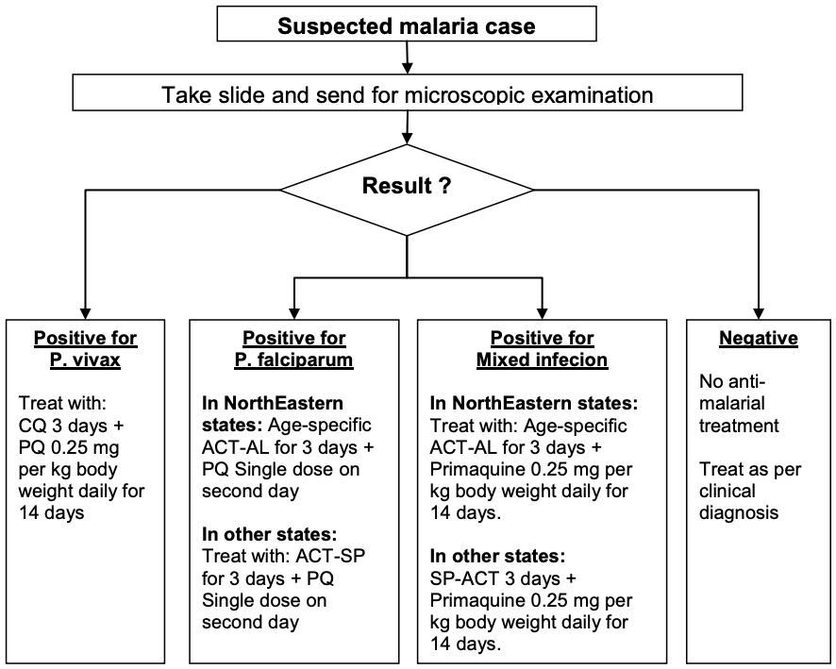
Malaria Treatment, Where microscopy result is available within 24 hours
1. ACT-AL - Artemisinin-based Combination Therapy- Artemether - Lumefantrine.
2. ACT-SP- Artemisinin-based Combination Therapy (Artesunate + Sulfadoxine Pyrimethamine).
3. CQ – Chloroquine.
4. PQ – Primaquine.

Slide 13
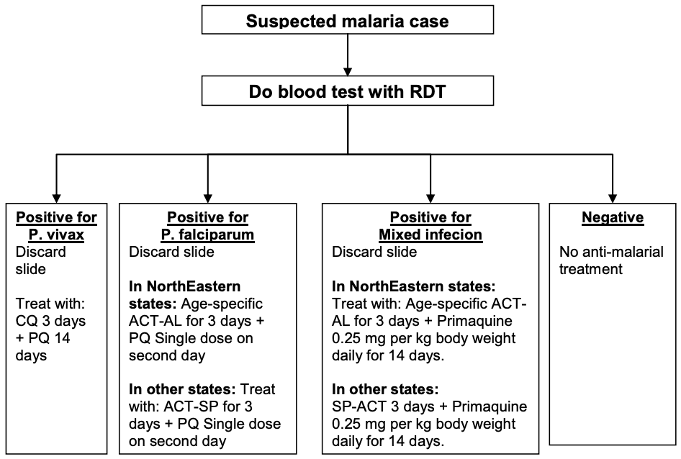
Where microscopy result is not available within 24 hours

Slide 14
Chloroquine Dosage schedule for P. Vivax Cases
Age (years) | Day 1 (10mg/kg) or Tablet | Day 2 (10mg/kg) or Tablet | Day 3 (5mg/kg) or Tablet
<1 | ½ tablet | ½ tablet | ¼ tablet
1–4 | 1 tablet | 1 tablet | ½ tablet
5–8 | 2 tablets | 2 tablets | 1 tablet
9–14 | 3 tablets | 3 tablets | 1½ tablets
≥15 years (including pregnant women) | 4 tablets | 4 tablets | 2 tablets
One chloroquine tablet = 250 mg (150 mg base), Adults receive 600 mg on Day 1 & Day 2, and 300 mg on Day 3
Primaquine Dosage schedule for P. Vivax Cases (for 14 days)
Age (years) | Daily dose (mg base) | No. of tablets (2.5 mg)
<1 | Nil | Nil
1–4 | 2.5 | 1
5–8 | 5.0 | 2
9–14 | 10.0 | 4
≥15 | 15.0 | 6

Slide 15
Treatment of Plasmodium vivax Malaria: Confirmed cases should be treated with:
Chloroquine 25 mg/kg body weight divided over 3 days.
Primaquine 0.25 mg/kg body weight daily for 14 days.
Treatment should be given under supervision, Chloroquine acts on blood stages, while primaquine eliminates liver forms and prevents relapse.
Treatment of Plasmodium falciparum Malaria:
All confirmed cases must receive Artemisinin-based Combination Therapy (ACT).
ACT should be combined with single-dose primaquine (0.75 mg/kg) on day 2.
Primaquine helps in gametocyte clearance and interruption of transmission.
Primaquine should NOT be used in: Pregnancy, Infants, G6PD-deficient individuals.
Treatment of Mixed Infections:
Mixed infections involving P. falciparum should be treated as falciparum malaria.
Primaquine can be given for 14 days, when indicated.
Treatment of Malaria in Pregnancy:
For Plasmodium falciparum malaria: Artemisinin-based combination therapy (ACT) is recommended in the second and third trimester. Quinine is recommended in the first trimester, Dose 600 mg tablet three times daily for 7 days.
Plasmodium vivax malaria during pregnancy can be treated with chloroquine.

Slide 16
Dosage Schedule of ACT for Plasmodium falciparum Cases
Age | Drug | Day 1 (No. of tablets) | Day 2 (No. of tablets) | Day 3 (No. of tablets)
< 1 year | AS | 1 | 1 | 1
 | SP | 1 | Nil | Nil
1–4 years | AS | 1 | 1 | 1
 | SP | 1 | Nil | Nil
5–8 years | AS | 1 | 1 | 1
 | SP | 1 | Nil | Nil
9–14 years | AS | 2 | 2 | 2
 | SP | 2 | Nil | Nil
15 years & above | AS | 1 | 1 | 1
 | SP | 2 | Nil | Nil
ACT = Artesunate (AS) + Sulfadoxine - Pyrimethamine (SP)

Slide 17
Dosage Schedule of Primaquine for P. falciparum (Single-Day Dose on 2nd day)
Age (years) | Dose (mg of base) | No. of tablets (2.5 mg) | No. of tablets (7.5 mg)
<1 | Nil | 0 | 0
1–4 | 7.5 | 3 | 1
5–8 | 15.0 | 6 | 2
9–14 | 30.0 | 12 | 4
15 and above | 45.0 | 18 | 6
A single dose of Primaquine 0.75 mg/kg body weight should be given on the first day.

Slide 18
Treatment Failure / Drug Resistance:
After completion of treatment, a patient is considered cured if there is no fever and no parasitemia up to day 28.
Treatment is considered a failure or there is drug resistance if the patient develops danger signs, severe malaria, or persistent parasitemia.
Early Treatment Failure (ETF): It is considered early treatment failure when:
The patient develops danger signs or severe malaria, and Parasitemia is present on day 1, day 2, or day 3, Irrespective of axillary temperature.
Late Clinical Failure (LCF): It is considered late clinical failure when:
Danger signs or severe malaria develop after day 3 and before day 28, and Parasitemia is present with axillary temperature ≥ 37.5°C.
Late Parasitological Failure (LPF): It is considered late parasitological failure when:
Parasitemia is present between day 7 and day 28, Axillary temperature is below 37.5°C, and The patient does not meet the criteria of ETF or LCF.
Management of Treatment Failure:
Treatment should be given with Artemisinin Combination Therapy (ACT) or Quinine with doxycycline.
Doxycycline is contraindicated in: Pregnancy, Lactation, Children below 8 years of age
Treatment failure with chloroquine in P. vivax malaria is rare in India.

Slide 19
Chemoprophylaxis:
Chemoprophylaxis should be given only to selected groups in areas with high P. falciparum transmission.
Use of insecticide-treated bed nets is encouraged for: Pregnant women & Other vulnerable populations including travelers and forest workers.
However, chemoprophylaxis should be followed wherever appropriate, especially for troops on night patrol duty.
Short-Term Chemoprophylaxis (Less than 6 weeks):
Drug of choice: Doxycycline (if not contraindicated).
Dose: Adults: 100 mg daily & Children: 1.5 mg/kg body weight, Start 2 days before travel & Continue for 4 weeks after leaving the malarious area.
It is contraindicated in: Pregnant women & Children below 8 years.
Long-Term Chemoprophylaxis (More than 6 weeks):
Drug of choice: Mefloquine.
Dose: 200 mg weekly, Start 2 weeks before exposure & Continue during stay and 4 weeks after exposure.
It is contraindicated in individuals with: Convulsions, Neuropsychiatric disorders, Cardiac diseases.

Slide 20
Malaria Control Strategies: Control of malaria includes three-pronged strategies:
Early Diagnosis and Complete Treatment: Case detection and management, Disease surveillance & Epidemic preparedness.
Integrated Vector Control: Indoor residual spraying, Insecticide-treated nets (ITNs), Long-lasting insecticidal nets (LLINs), Biological control & Source reduction.
Training and Capacity Building: Health workers and field staff are trained regularly to improve skills in diagnosis, treatment, surveillance, and vector control activities.
Behaviour Change Communication (BCC): Health education is provided to the community to promote: Use of bed nets, Early reporting of fever & Compliance with treatment.
Intersectoral Collaboration: Different sectors such as health, urban development, irrigation, forestry, and education work together to control malaria.
Community Participation: Active involvement of the community is encouraged in: Source reduction, Use of preventive measures & Reporting of fever cases.
Public Private Partnership: Involvement of: NGOs, Indian Medical Association, Community-based organizations (CBOs), This helps in improving coverage and effectiveness of malaria control.
Monitoring, Evaluation, and Supportive Supervision: Regular monitoring and evaluation ensure proper implementation of malaria control activities and identify gaps for improvement.
Legislation: Legal provisions help enforce measures such as mosquito control, sanitation, and environmental management.

Slide 21
Early Diagnosis and Complete Treatment:
Case Detection and Management: Early detection and prompt treatment of malaria cases is essential to Reduce morbidity and mortality & Prevent transmission.
Disease Surveillance: Disease surveillance is defined as the ongoing, systematic collection, analysis, interpretation, and dissemination of health data. It is used for: Planning, Implementation, Evaluation of disease prevention and control activities, Surveillance is of two types:
Passive Surveillance: Malaria cases are detected when patients with fever visit health facilities such as: Primary Health Centers (PHCs), Community Health Centers (CHCs), District Hospital. Blood smears are collected and examined by microscopy.
Active Surveillance: Conducted by health workers or Multipurpose Workers (MPWs), MPWs visit villages regularly and conduct house-to-house visits.
They look for:
New fever cases, Fever cases that developed since last visit, Blood smears (thick and thin) are collected or RDTs are performed, Slides are sent to PHC laboratory for examination
Traditionally:
Health workers give a single dose of chloroquine while collecting blood smear (presumptive treatment).
Confirmed cases are treated with chloroquine for 3 days.
RDTs are used mainly for P. falciparum cases.

Slide 22
Radical Treatment
After confirmation by blood smear:
Positive cases are given radical treatment
Treatment aims to completely eliminate parasites and prevent relapse
Follow-up of Malaria Cases
All positive cases, especially P. falciparum, should be followed up
Follow-up blood smears are taken:
Between 3rd and 7th day after starting treatment
Preferably on 6th day after first dose of treatment or RDT
If parasites persist, repeat treatment is given.
Suspected Case of Malaria (Case Definition)
A suspected malaria case is defined as:
A patient with fever living in an endemic area during transmission season, or
A person who has recently visited an endemic area, and
No other confirmed diagnosis
Rapid Fever Surveillance (RFS)
When a malaria outbreak is suspected, a rapid survey is conducted
Fever cases are detected and blood smears are examined on the same day
Radical treatment is given as early as possible
RFS is also done in villages where:
A case is detected
MPWs are not visiting regularly
The objective is to control outbreaks quickly.

Slide 23
Mass Survey
Blood smears are collected from every individual in the village, irrespective of fever
The objective is to assess:
Magnitude of malaria
Parasite prevalence among asymptomatic individuals
Contact Survey
Blood smears are taken from contacts of a confirmed P. falciparum case
The objective is to detect spread of infection among contacts
Fever Treatment Depot (FTD)
Any person like:
Accredited Social Health Activist (ASHA)
Identified social health activist
Who is trained to collect blood smears from fever cases constitutes an FTD. This ensures round-the-clock availability of malaria surveillance.
Drug Distribution Centre (DDC)
Centers where:
Blood smears are collected
Presumptive treatment is given
These centers are supervised by FTDs.

Slide 24
Investigations During Outbreak
A fever outbreak is an emergency, and investigations must begin immediately.
DMO / DHO / DSO should be informed at once
They should be members of the rapid response team
Field Investigations
Rapid fever survey is conducted in affected villages
All households are visited
A temporary laboratory may be set up
Blood smears are examined immediately
Positive cases are treated without delay
Treatment During Outbreak
Chloroquine is given if appropriate
If blood smear results are delayed, treatment should not be postponed
All high-risk groups must be covered, especially:
Children
Pregnant women
Migrants
The rapid fever survey should be conducted daily and continued until no fever cases are seen for at least 10 days, to rule out further outbreaks.

Slide 25
Integrated Vector Control:
Indoor Residual Spray (IRS):
Synthetic Chemical Insecticides Used for IRS: DDT 50%, Malathion 25%, Synthetic pyrethroids.
Insecticide-Treated Bed Nets (ITNs) and Long-Lasting Insecticidal Nets (LLINs):
Nets treated with: Organophosphorus compounds & Synthetic pyrethroids.
LLINs remain effective for up to 20 washes.
Biological Control: Biological methods are used to reduce vector breeding and density.
Source Reduction: Eliminate mosquito breeding sites such as: Drainage of stagnant water, Filling pits and pools, Proper water storage practices.

Slide 26
Malaria Vaccine:
In October 2021, WHO recommended the large-scale use of the malaria vaccine RTS,S/AS01 (Mosquirix®) for the first time.
Recombinant vaccine, It is the world’s first human anti-parasite vaccine, Developed by GlaxoSmithKline (GSK).
Effective against P. falciparum only.
Recommended in children living in moderate to high transmission areas.
Vaccination Schedule: WHO recommends a 4-dose schedule:
First dose at 5 months of age.
Second and third doses at monthly intervals.
Fourth dose at 15 - 18 months of age.
Reduces malaria morbidity and mortality in children.
Safe with no adverse effect on routine immunization.
Effectiveness about 40%.
Cost-effective.

Slide 27
Thanks

